Slide 1
URA Presentation
Prepared by Debbie
Mentored by Alvin

Slide 2
Content
Recap of Interim Findings
Uncertainty Quantification
Data Quality Framework
Data Imputation
HDB Resale Data to Demonstrate
Exploratory Data Analysis
Tests for Missingness Mechanism
Imputation Techniques
Evaluate Results of Imputation
Identifying Similar Units
Key Discussions

Slide 3
Interim Findings on Resi Data
~60% complete dataset (resi only) after aggregation from multiple sources: EMA, PUB, PropertyGuru, planning area dataset
Questions to answer in order of priority:
DQ Framework
Imputation techniques for partial data & how imputation accuracy quantification
Clustering to identify similar units - use complete data or complete+imputed data?
Notes:
With significant amount of missingness, first question is how to quantify it?

Slide 4
Uncertainty Quantification (≠ DQ)
Looking at sources of uncertainty in numerical simulation
Modelling = input → model → output
This field of study looks at how variances in input are reflected by output
In this project’s case, look at:
How missing values (uncertainty) in dataset affects modelling outputs e.g. k-means clustering to identify ‘problematic’ units

Slide 5
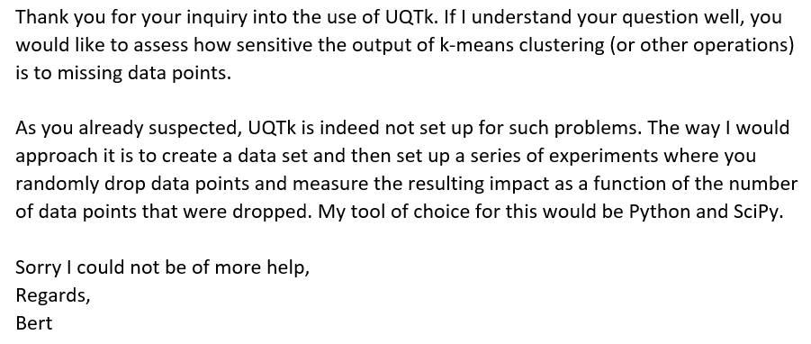
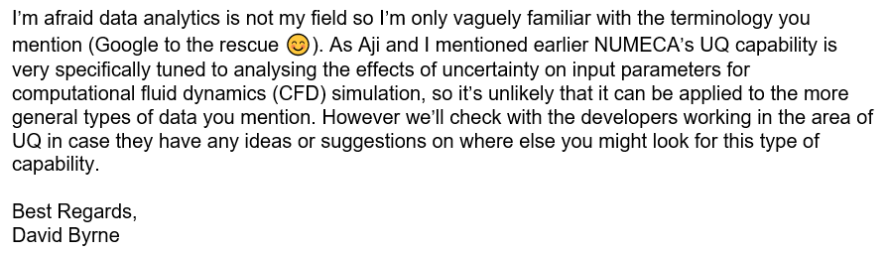
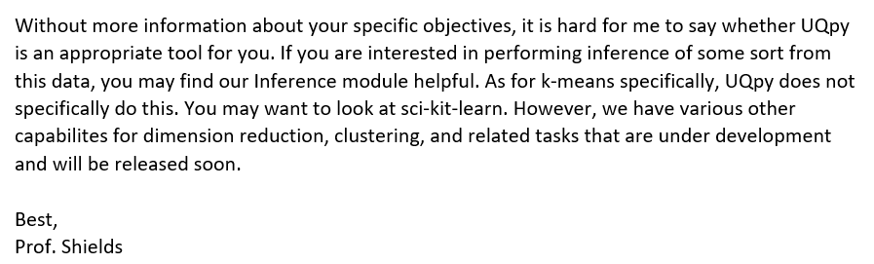
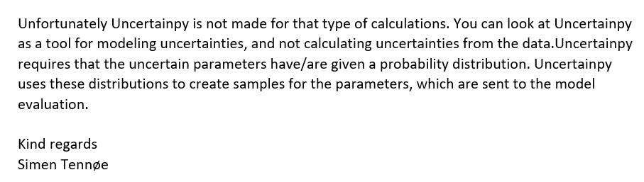
Uncertainty Quantification
Notes:
Looked into numerous packages: UQpy & Uncertainpy (python), UQTk, NUMECA UQ (commercial tools), UQLab (MATLab)
But unfortunately it is not applicable to our case because the uncertainty in question comes from variance in the input values depending on its distribution, not missingness
Uncertainty != missingness. Explain main difference. Uncertainty in UQ = variance in a particular value due to its distribution
A lot of work available to deal with missingness but no framework

Slide 6
Proposed DQ Workflow
DQ of incomplete dataset
EDA of incomplete dataset
Determine mechanism of missingness
Missing Completely at Random (MCAR)
Missing at Random (MAR)
Missing not at Random (MNAR)
Impute
Evaluate imputation results

Slide 7
DQ Framework
DQ dimensions
DQ dashboard to show current state vs desired state
Scorecard to compare DQ over time + track progress
Notes:
I think what DQ framework does is not to give a scientific indicator of the quality of data, but rather a rough and layman gauge of how a dataset is. Rather than just blindly using data and assuming it is fine because garbage in garbage out.
Maybe ultimate goal when you use a dataset is to report on DQ dimensions of a data + imputation of data (then use the values on tested subsets to show how accurate imputation CAN be)
But ultimately no scientific base because there is no ground truth
Dq vs uq: dq looks mainly at the data quality dimensions and how dataset performs

Slide 8
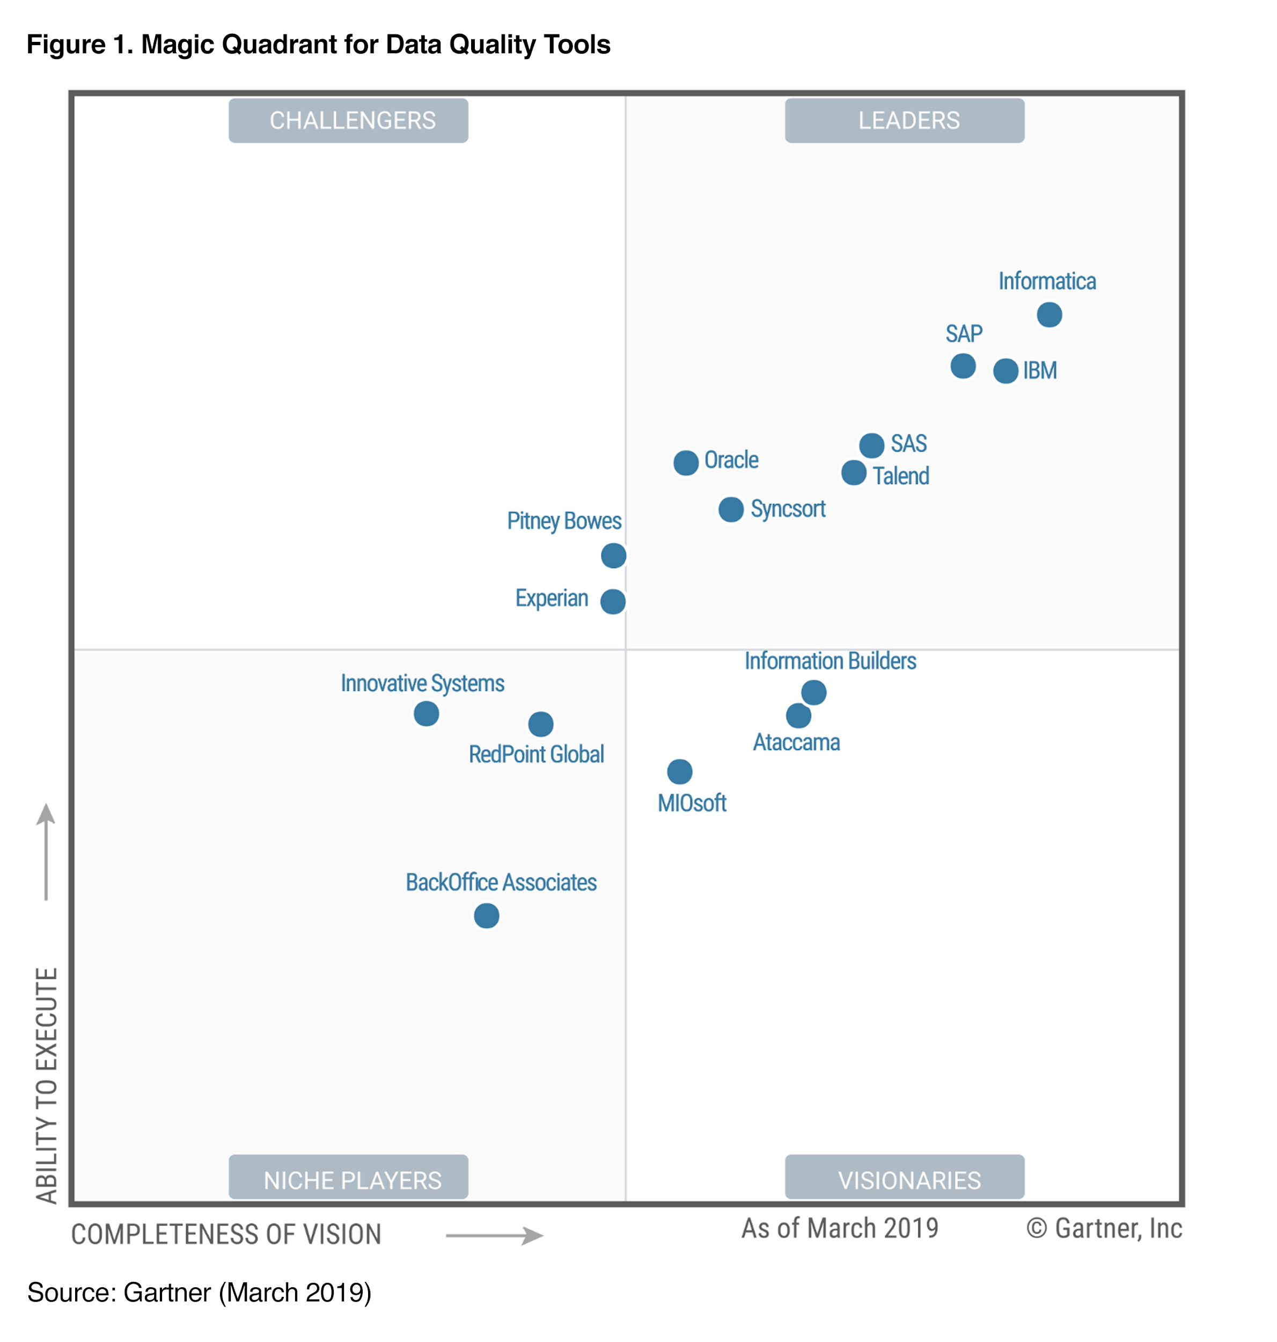
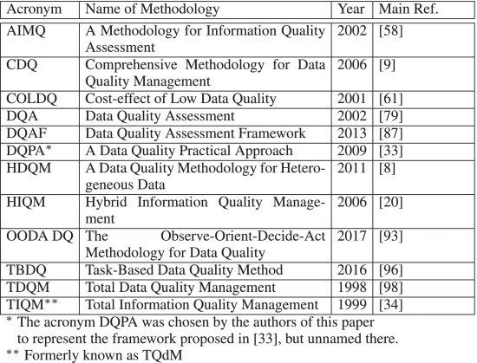
DQ Framework
Tons of different frameworks out there; generally measures same few things
Notes:
At least 20 different frameworks out there in the industry

Slide 9
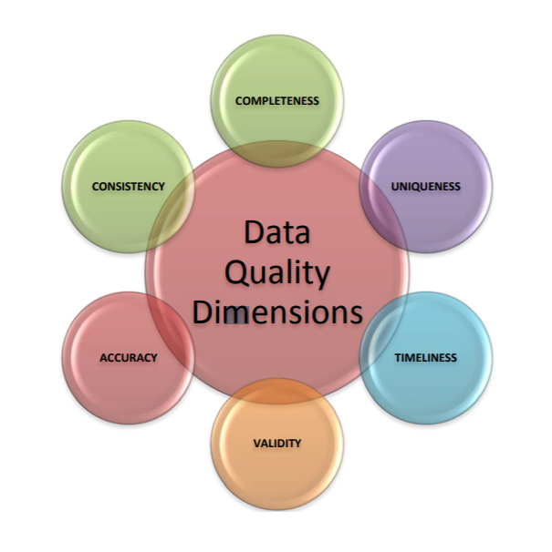

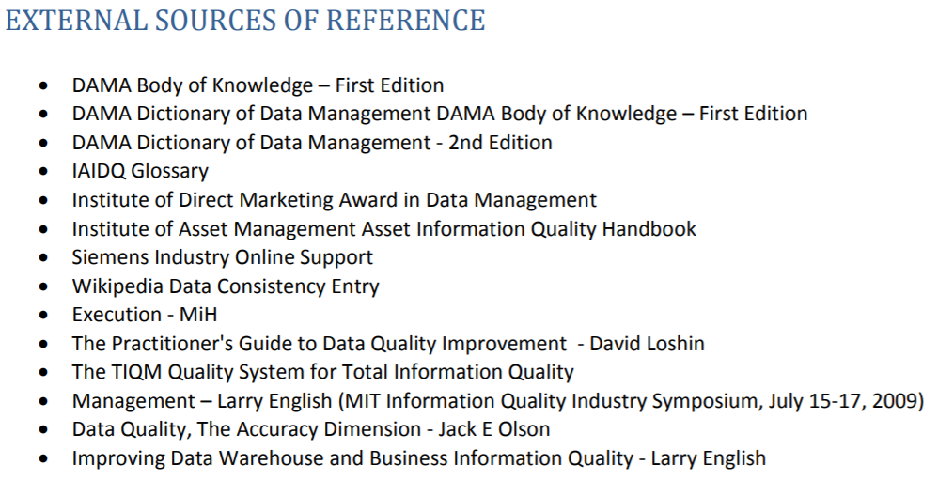
DQ Framework
Notes:
Chose this framework because
Firstly its simple and easy to use
Secondly it is a combination of work by experts in the field and existing frameworks so there is confidence in the framework
Thirdly it is similar to what the DQ tools by Gartner Magic Quadrant does (IBM had a rough sample of it)/M&S/PwC

Slide 10
DAMA’s DQ Framework
Completeness: The proportion of stored data against the potential of "100% complete"
Uniqueness: No thing will be recorded more than once based upon how that thing is identified
Timeliness: The degree to which data represent reality from the required point in time
Validity: Data are valid if it conforms to the syntax (format, type, range) of its definition.
Accuracy: The degree to which data correctly describes the "real world" object or event being described.
Consistency: The absence of difference, when comparing two or more representations of a thing against a definition.
Notes:
Number 2, 3 not applicable
Number 4, 5 no ground truth
Completeness %
Uniqueness % (possibility of duplicate unit address data rows. Check why?)
Timeliness % (maybe not rly applicable since data is monthly?)
Validity % (data format/range/type)
Accuracy (almost impossible because we have no ground truth). Maybe when we cross check data?
Consistency (same across different data sources)
Confidence of data
Value of data

Slide 11
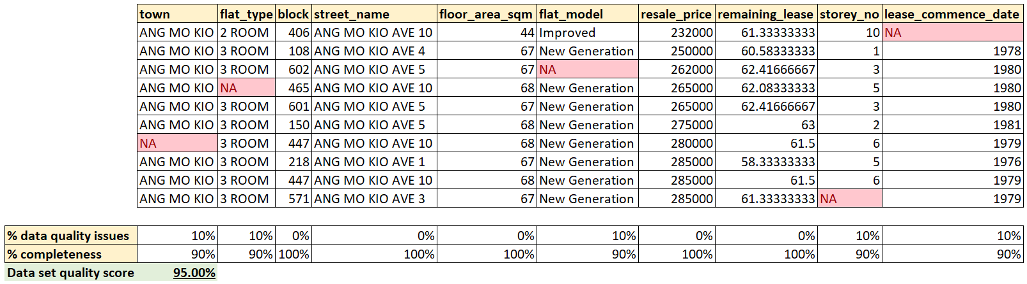
DAMA’s DQ Framework
Quantify data quality dimension in % for every column
Take the average/weighted score to calculate total data set quality score
Notes:
InfoSphere Information Analyzer: https://www.ibm.com/support/knowledgecenter/SSZJPZ_11.7.0/com.ibm.swg.im.iis.ia.product.doc/topics/c_quality_score.html
Simulating % completeness

Slide 12
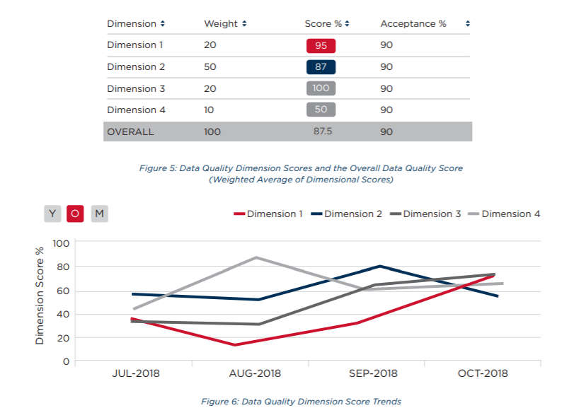
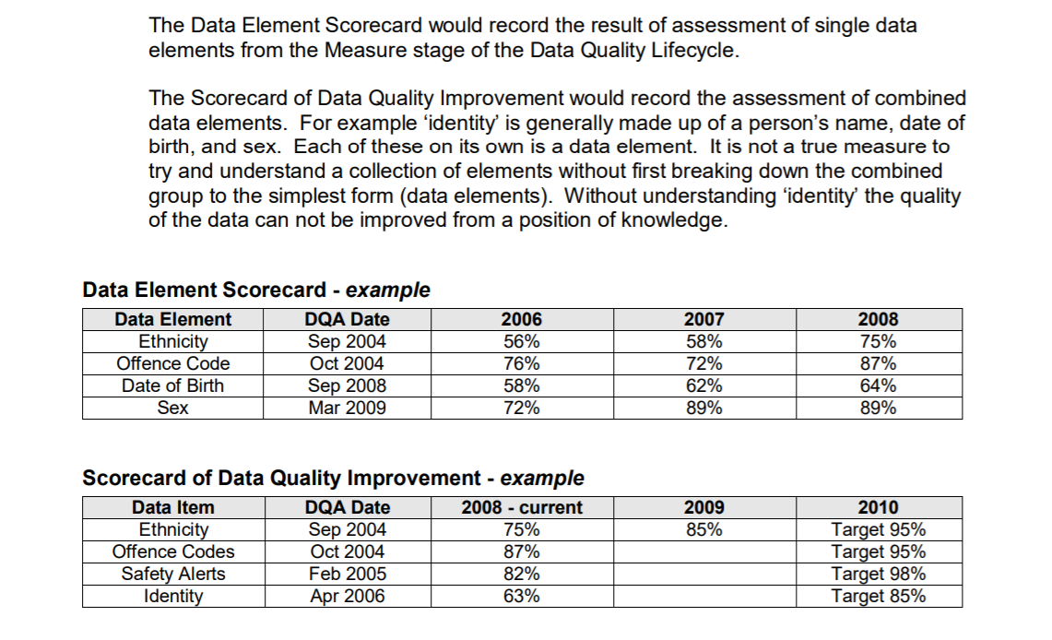
DQ Framework
Scorecard to provide time analysis
Notes:
Main point is to see whether data quality is improving over time

Slide 13
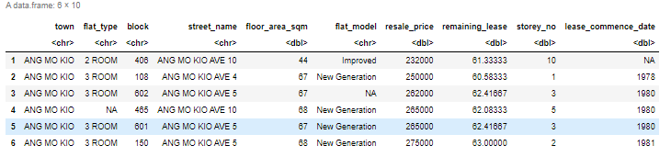
HDB Resale Data
https://data.gov.sg/dataset/resale-flat-prices?resource_id=42ff9cfe-abe5-4b54-beda-c88f9bb438ee
6704 rows x 10 columns
3 categorical, 5 continuous
Simulated storey_no + introduced 40% incomplete observations
So data should be MCAR
Notes:
Total 10-2=8 variables
Excluded block and street_name from analysis

Slide 14
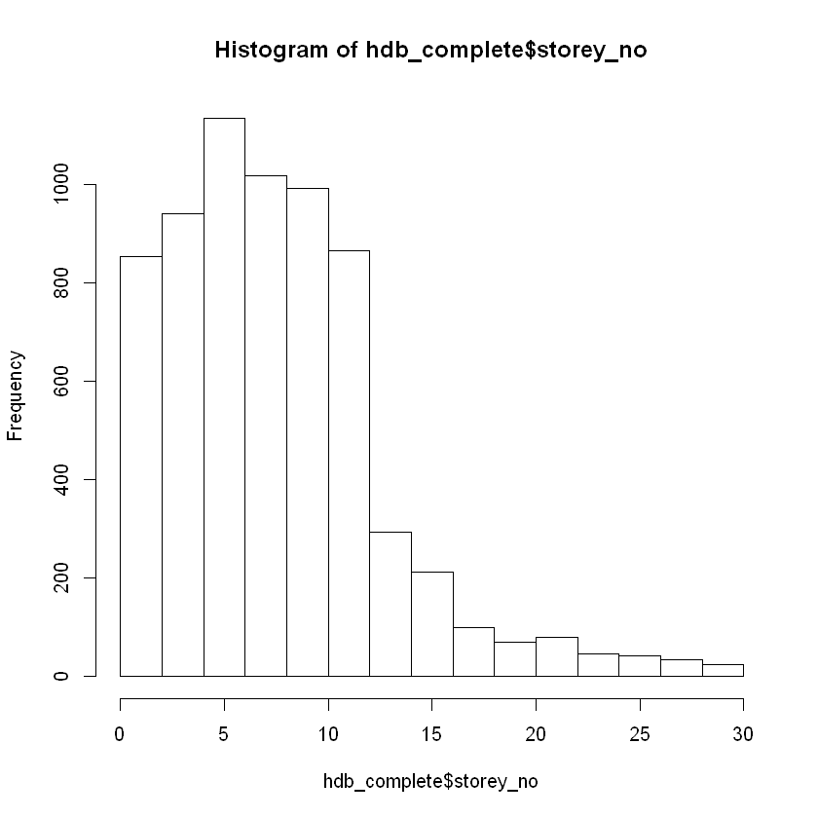
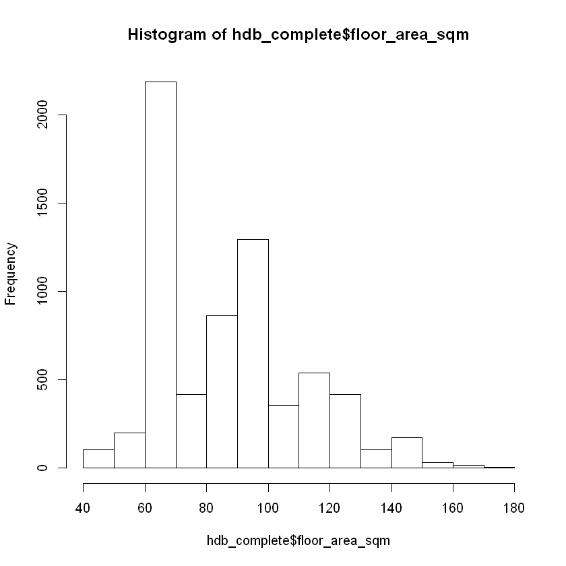
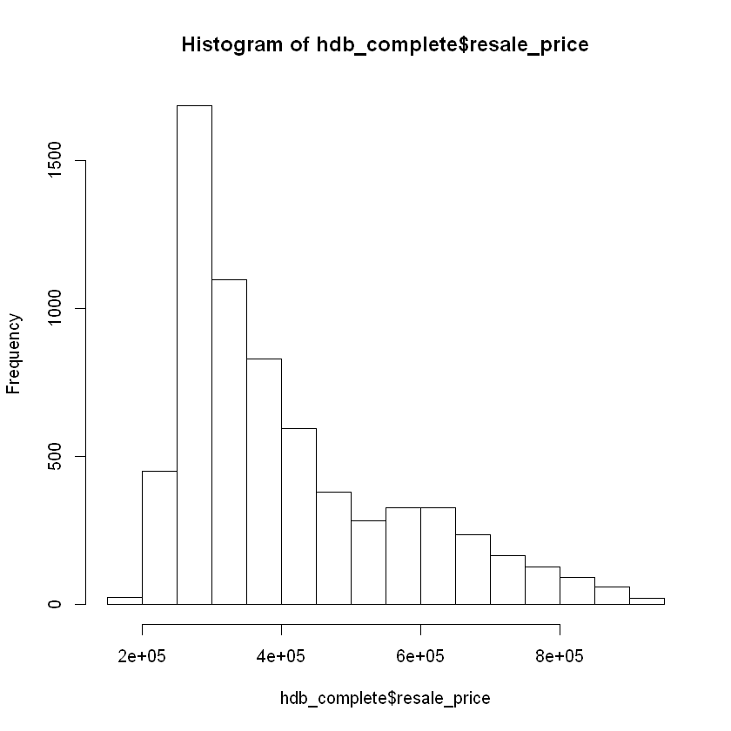
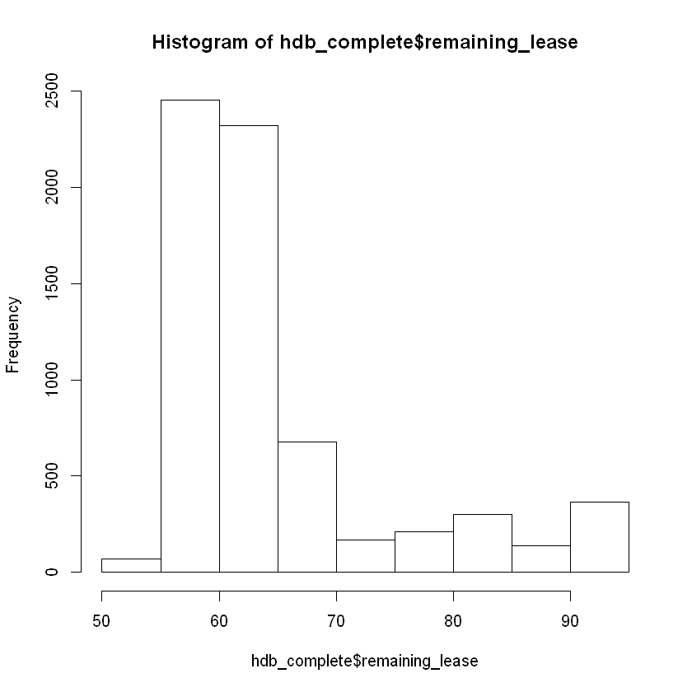
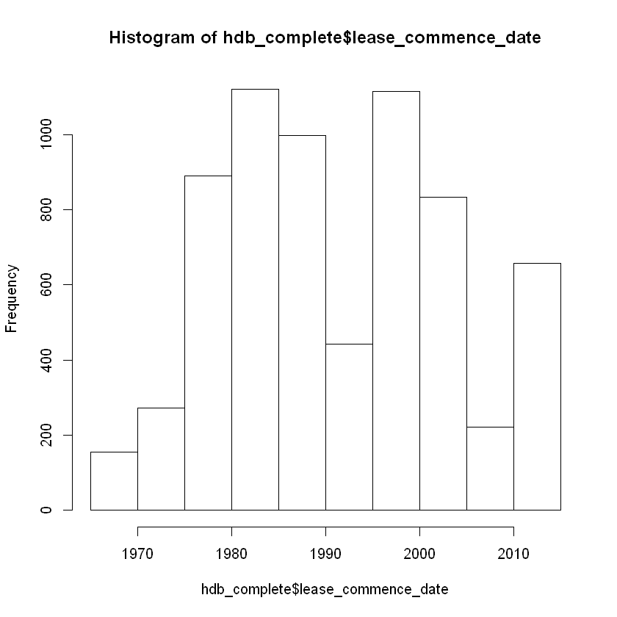
HDB Resale Data EDA (before)
Stochastic distribution
Notes:
Show before

Slide 15
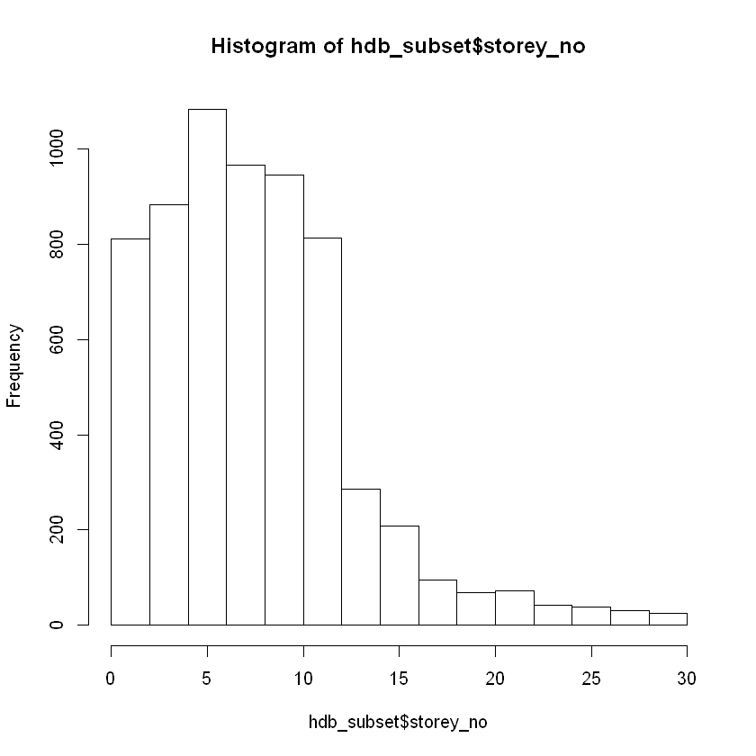
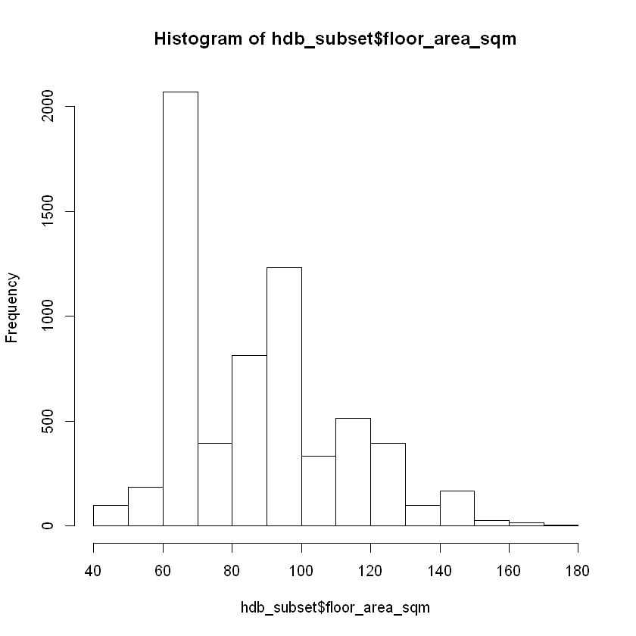
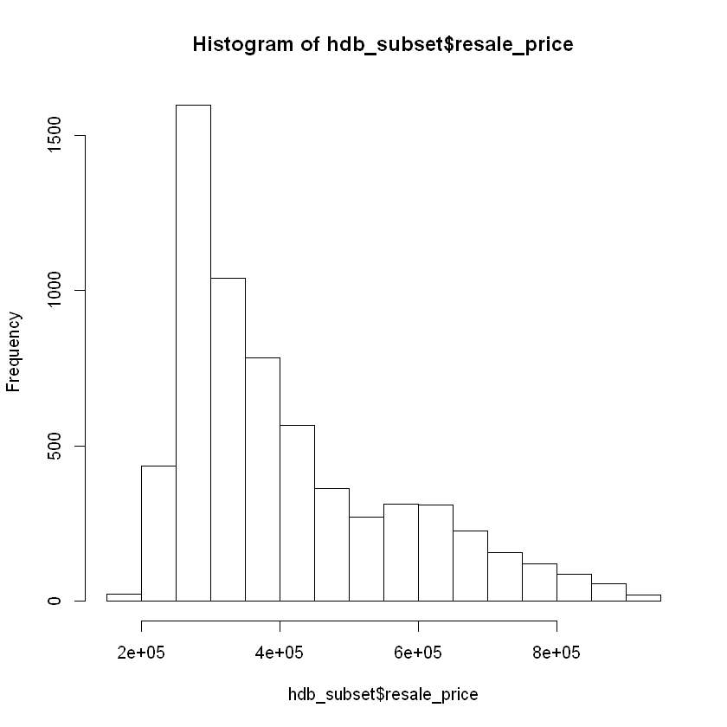
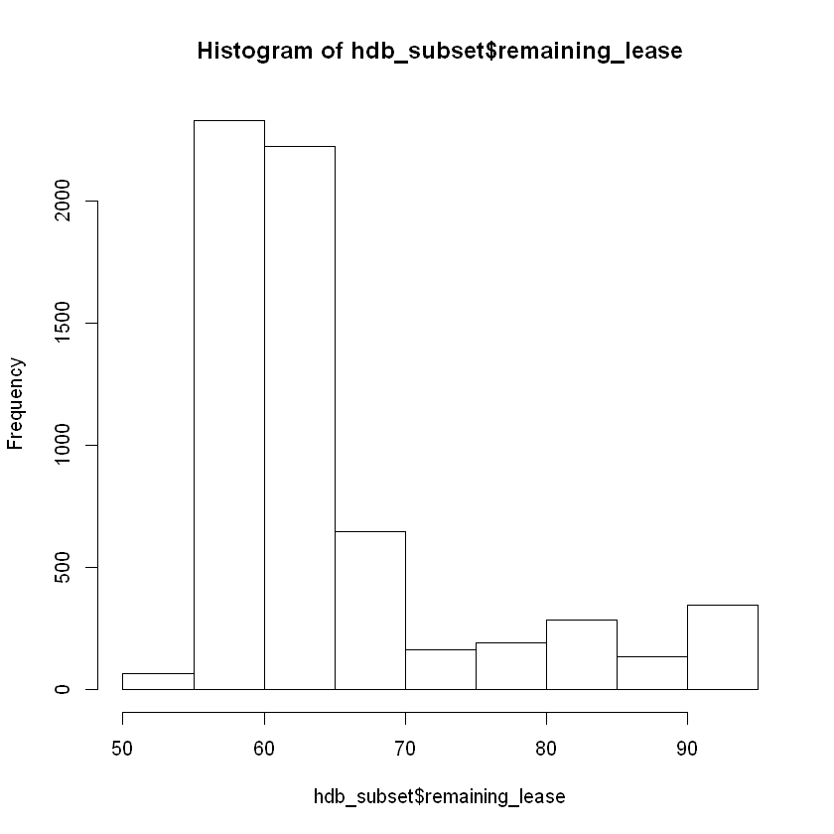
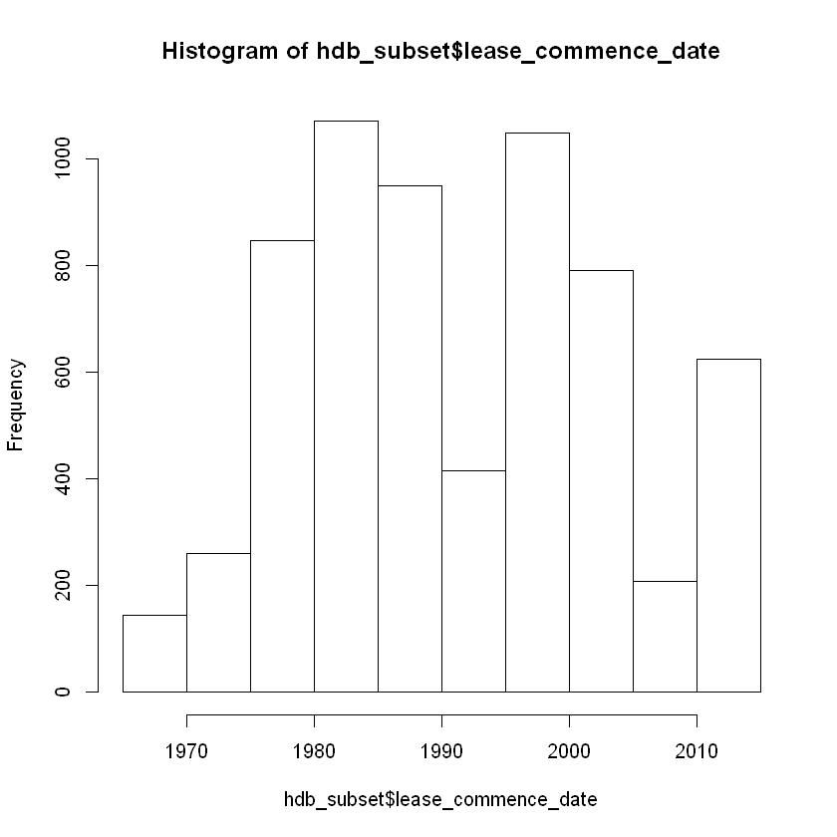
HDB Resale Data EDA (after)
~59% completeness
Stochastic distribution across continuous variables
Notes:
Ie. simulation of missingness did not change properties of data

Slide 16
Types of Missingness
Only experts will know its a circle!
Random Missing Data Spots
Subset of Data
Severity
of
Missingness
MCAR
(missing completely
at random)
MAR
(missing at random)
MNAR
(missing not at random)
Missing based on random chance
Missing because of another variable
E.g. TOP dates for AMK are missing
Missing because of the variable itself
E.g. data rows relating to units in AMK are missing
Notes:
Importance of identifying potential type of missingness because type of imputation strategies depends on it
Missing Completely at Random (MCAR)
Probability of missingness unrelated to any variables
Missing at Random (MAR)
Probability of missingness related to certain variables
Missing Not at Random (MNAR)
Probability of missingness depends on the missing value itself

Slide 17
Tests to Determine Missingness Mechanism
Test | Steps | Findings
Shadow Matrix | Encode dataset into 0 or 1 Check correlation between missingness | Can only identify which variables tend to be missing together
Test Missingness for Independence | Combine shadow matrix with original dataframe Check correlation of missingness | Potentially identify MAR (tendency for a variable to be missing when another variable is of certain value)
Statistical MCAR Test | BaylorEdPsych R package Implementation of Little’s MCAR test Assumes multivariate normality Supports mixed variables MissMech R Package Works for non-parametric distributions Do not support categorical variables | Support for only either mixed variables or non-parametric distributions
Notes:
Only can have indicator of MAR/MCAR missingness
Almost impossible to prove MNAR unless with expert guidance
If really cannot usually people will just assume MAR
Main downside: will go OOM if too many data rows are involved. E.g. > 10k
Depends on user data
E.g. 2. Do larger values tend to be missing?

Slide 18
Tests to Determine Missingness Mechanism
Rejected?
BaylorEdPsych
No
MissMech
Yes
Data is not MCAR statistically
Yes
Rejected?
Possible that data is MCAR
No
Notes:
Can only help to reject that data is MCAR
These tests can only be indicative of whether data is MCAR or not
No 100% way to find out data missingness mechanism

Slide 19
Imputation Strategies for MNAR
Both different in their ways of calculating joint distribution P(Y, R) where Y is the variable to be imputed and R is =0 if missing and =1 if non missing:
Selection models
P(Y, R) = P(Y)P(R|Y)
Pattern mixture models
P(Y, R) = P(R)P(Y|R) → the exact opposite of selection model
= P(Y|R=1)P(R=1) + P(Y|R=0)P(R=0)
Notes:
First you do EDA and have experts to roughly identify where missing values tend to range
Kaplan-Meier estimation of marginal distribution and response weights
Both models estimate δ. Then imputed values under MAR models (e.g. PMM) and add a simple shift parameter δ to the missing data to account for shift/scale/shape bias in distribution of missing data
Sensitivity analysis comes in when you compare results under different values of δ
Both different in their way of calculating joint distribution P(Y,R)
https://www.idescat.cat/sort/sort372/37.2.2.satty-mwambi.pdf
https://stefvanbuuren.name/fimd/sec-nonignorable.html#sec:nonignorableoverview
https://cran.r-project.org/web/packages/miceMNAR/miceMNAR.pdf

Slide 20
Imputation Strategies for MNAR
Conduct EDA and have experts roughly identify where missing values tend to range
Impute values under MAR models (e.g. PMM)
Both models estimate differences (x) in mean of missing vs observed data using P(Y, R)
Sensitivity analysis: Come up with a few sensible δ adjustment values to adjust the imputed values (e.g. shift/scale/shape distribution of data) and identify which δ produces a value closest to the difference (x) in step 3 ie. difference between mean of imputed and observed values should be similar to difference (x) in step 3
Notes:
First you do EDA and have experts to roughly identify where missing values tend to range
Both models estimate δ. Then imputed values under MAR models (e.g. PMM) and add a simple shift parameter δ to the missing data to account for shift/scale/shape bias in distribution of missing data
Sensitivity analysis comes in when you compare results under different values of δ
Both different in their way of calculating joint distribution P(Y,R)
https://www.idescat.cat/sort/sort372/37.2.2.satty-mwambi.pdf
https://stefvanbuuren.name/fimd/sec-nonignorable.html#sec:nonignorableoverview
https://cran.r-project.org/web/packages/miceMNAR/miceMNAR.pdf

Slide 21
Imputation Strategies for MCAR/MAR
Simple Imputation
Only one dataset generated
Low level (e.g. mean/mode) to ML techniques
Multiple Imputation
Multiple datasets generated
Reflects uncertainty across the different datasets generated
MICE is most common
Benchmarking/comparison:
Comparison
NRMSE
PFC
Notes:
NRMSE between 0 and 1
0 = perfect imputation
1 = as good as mean imputation (aka useless)
For continuous variables
PFC
Percentage of false classification
For categorical variables (can leave data in factor form)

Slide 22
Imputation Strategies
Imputation Strategies
Single Imputation
Multiple Imputations
Statistical Imputation
Imputation Based on ML
Imputation Based on ML
Mean/mode impute
Iterative Random Forests
KNN
FAMD
Bayesian PCA
CART MICE
RF MICE
Hmisc aregImpute

Slide 23
Imputation Strategies Taxonomy
Imputation Strategies
Statistical
Imputation
Imputation based on ML
Central Value Representation
Decision Trees
Distance-based
Dimensionality Reduction
Mean/Mode Imputation
Fit bootstrap samples to multiple trees
Dataset fitted to one tree
Linear combinations of variables
Linear combinations of latent variables
Random Forests
CART
Bayesian PCA
FAMD
Takes median/mode of k neighbors
Takes value of a random neighbor
KNN
Hmisc aregImpute
Notes:
In statistics, latent variables are variables that are not directly observed but are rather inferred from other variables that are observed. Mathematical models that aim to explain observed variables in terms of latent variables are called latent variable models

Slide 24

Random Forests
Notes:
https://camo.githubusercontent.com/22cf4bccd4e6910fe5858118bb371dda3565a415/68747470733a2f2f63646e2d696d616765732d312e6d656469756d2e636f6d2f6d61782f3539322f312a69306f386d6a4666436e2d754437392d463143716b772e706e67
Develop different trees from the same dataset
Voting system

Slide 25
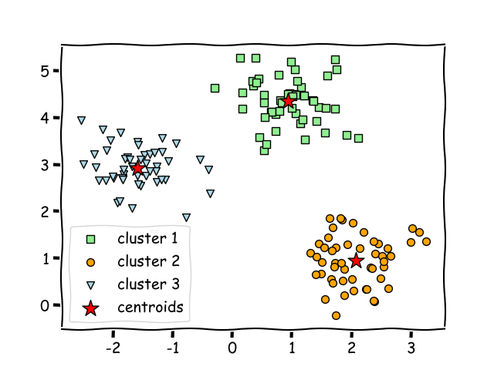
Nearest Neighbor Clustering
Notes:
Have a centroid in each cluster
Ideally the aim is to have clusters as tight as possible and be as distant as possible from the other clusters

Slide 26
Evaluating Results of Imputation
Strategy | Description | NRMSE | PFC
Mean/mode imputation | Continuous variables - replaced with mean of column Categorical variables - replaced with mode of column | 0.40 | 0.47
Iterative Random Forests | Iterative in that variables with least missing values are imputed first using predictions from random forests Repeated till predictions stabilized Do not rely on distributional assumptions | 0.09 | 0.08
CART MICE | CART with MICE | 0.12 | 0.11
KNN | Identifies k closest observations using Gower distance Median for continuous variables, mode for categorical variables | 0.12 | 0.15
RF MICE | Random Forests with MICE | 0.16 | 0.22

Slide 27
Evaluating Results of Imputation
Strategy | Description | NRMSE | PFC
Hmisc | Predictive mean matching | 0.18 | 0.27
FAMD | Principal component method of imputation FAMD on complete dataset and reconstruct to predict missing values | 0.17 | 0.40
Bayesian PCA | Defines probability distribution of variables to draw new parameters | 0.16 | 0.46

Slide 28
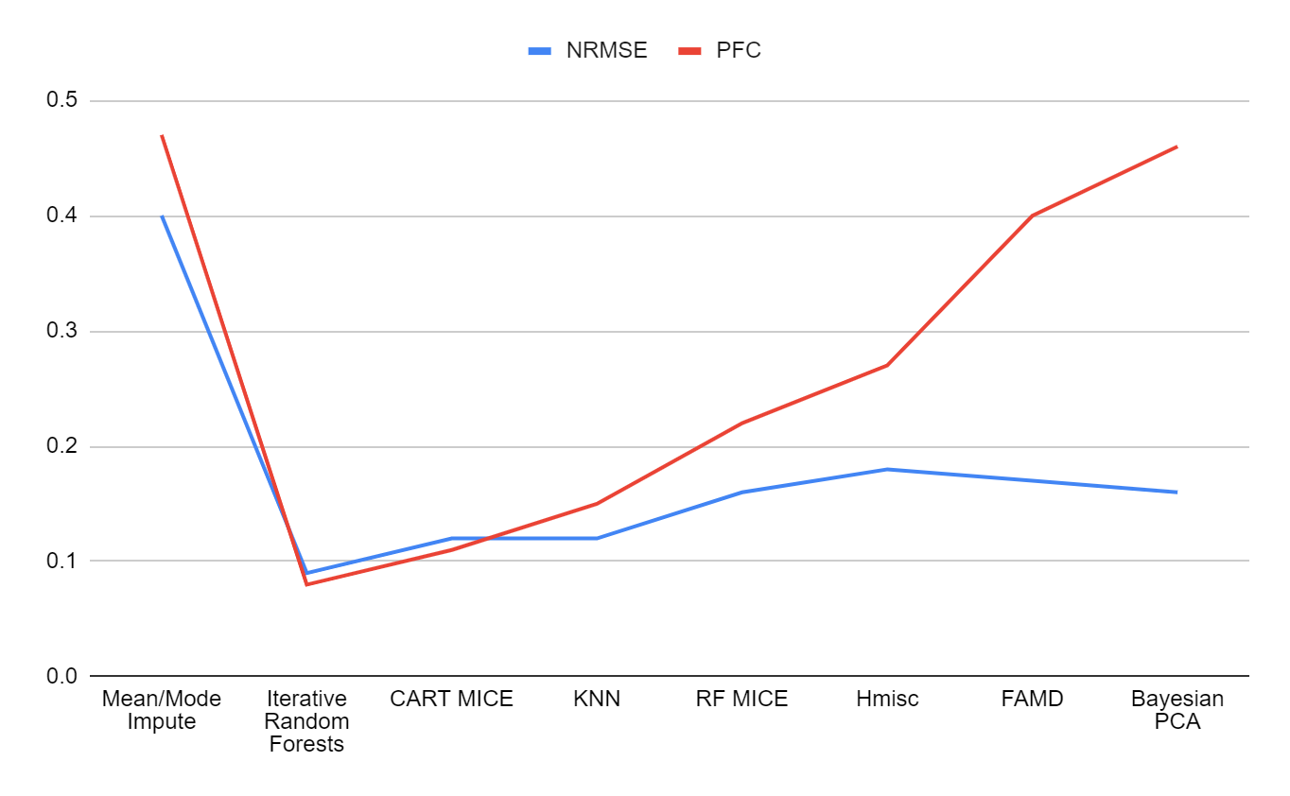
Evaluating Results of Imputation
Notes:
General desc - NRMSE is pretty stable and low. But PFC results for the last 3 mrthods are terrible
Mean/mode produces the worst result. Because this method will introduce bias to the data, it may make the dataset worse off than before
Followed by Bayesian PCA. because it is not meant to be used for categorical data, and that includes encoded ones. But it worked well for numerical data
Ordinal data → gower distance has the ability to consider ordinal data
Followed by FAMD. potentially it may be because SVD reduces the representative power of the dataset. FAMD and Bayesian PCA has potential to predict well for numerical variables, but not categorical variables
Iterative random forests and CART MICE produce the best result. Can deduce that decision tree based algorithms work very well for this dataset. KNN too. And this is supported by other researches which found similar findings

Slide 29
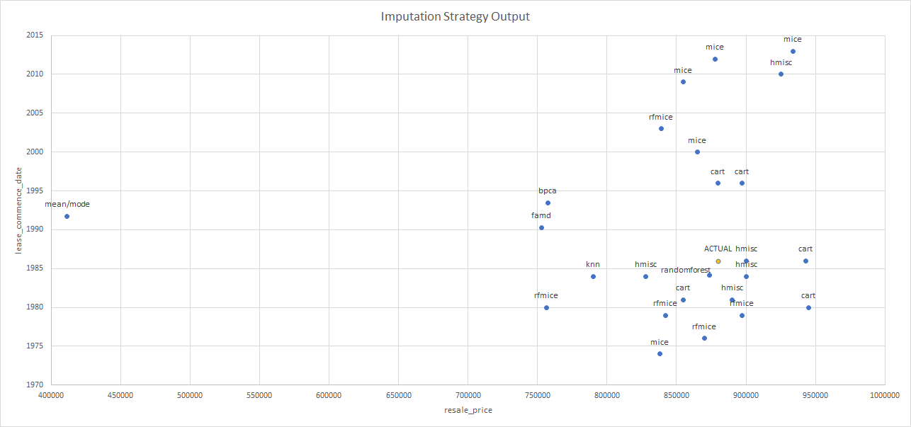
Evaluating Results of Imputation
The closer you are to ACTUAL, the better the imputation
Notes:
One observation in dataset
The closer you are, the better the imputation
One example. Lease_commence_date and resale_price are missing
Supports the previous slide’s reasonings

Slide 30
Evaluating Results of Imputation
Strategy | Results Ranking | Mixed Variables? | Assumes Distribution? | Runtime
Iterative Random Forests | 1 | ✔ |  | 11 mins
CART MICE | 2 | ✔ |  | 2 mins
KNN | 3 | ✔ |  | 11s
RF MICE | 4 | ✔ | ✔ | 4 mins
Hmisc | 5 | ✔ |  | 26s
FAMD | 6 | ✔ |  | 1.5s
Bayesian PCA | 7 |  | ✔ | 17 mins
Mean/mode Imputation | 8 | ✔ | ✔ | 0.04ms
Notes:
Bring back EDA. a lot don't fit normal dist

Slide 31
Identification of Similar Units
Distance matrix
Gower Distance: best type of distance metric chosen for each type of variable
Clustering Strategies
K-medoids
K-means
Fuzzy-c means
Hierarchical
Notes:
Pros and cons of each strategy

Slide 32
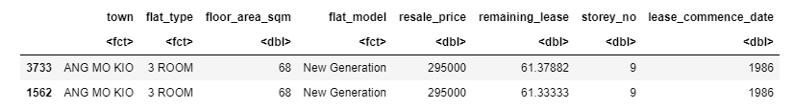
Identification of Similar Units - Distance Matrix
Compute distance matrix using Gower Distance
Only 7s
Notes:
Example is a pair of the most similar units in the dataset

Slide 33
Identification of Similar Units - Clustering Strategies
Clustering Strategies
Hard Clustering
Soft
Clustering
Centroid Models
Connectivity Models
Hierarchical
Fuzzy c-means
Observation as Centroid Mean
Exact Centroid Mean
K-medoids
K-means
Notes:
Hard clustering: each data point either belongs to a cluster completely or not. E.g. a person to be put into male/female cluster
Centroid models: closeness determined by data point’s distance to centroid of clusters
Connectivity: data points closer in data space exhibit more similarity to each other than data points far away.
Soft clustering: probability or likelihood of data point to be in clusters assigned

Slide 34
Identification of Similar Units - Clustering Evaluation
Extrinsic measures (ie. with ground truth/labels)
Intrinsic measures
Silhouette Coefficient | Dunn Index
Estimates average distance between clusters Range between -1 to 1 Close to 1: observation is well matched to assigned cluster Close to 0: borderline between 2 clusters Close to -1: observations may be assigned to wrong cluster Ideally should be > 0.4 | Higher values means that clusters are compact and well-separated from other clusters Should be maximised (Minimum inter-cluster distance)/(maximum cluster size) Ie. larger inter-cluster distance and smaller cluster size will lead to higher DI value
Notes:
Intrinsic more for our case because we have no ground truth
https://www.datanovia.com/en/lessons/cluster-validation-statistics-must-know-methods/

Slide 35
Identification of Similar Units - Clustering Evaluation
 | Silhouette Index | Dunn Index | Mixed Data? | Runtime
K-medoids | 0.5 | 0.01 | ✔ | 3 mins
Hierarchical | 0.4 | 0.17 | ✔ | 3s
Fuzzy-c means | - | - |  | -
K-means | - | - |  | -
Notes:
No need to consider fuzzy c-means/k-means because they cannot accommodate for categorical variables
In this case hierarchical clustering is more suited for the data

Slide 36
Concluding Results
DQ Framework
DAMA UK’s 6 dimensions
Missingness Mechanism
Expert to identify potential missingness pattern
Run the 3 tests to have an indication of potential pattern
Recommended Imputation Strategies (if MCAR/MAR)
Iterative Random Forests
CART MICE
KNN
Identification of Similar Units
Gower distance matrix
Distance matrix > clustering matrix, because its more straightforward in the output and computation
Notes:
EDA is meaningful if people is familiar is dataset is doing it
Data is stochastically distributed. Affects the techniques chosen to impute

Slide 37
Key Discussions
DQ framework
Which dimensions are most important for the data?
Baselines set for each dimension
What to do when quality baseline isn’t met?
Need to identify type of missingness
This requires experts to do so/people familiar with the dataset
Imputation strategies can be tested on complete portion of data to see which works best
Clustering - When to apply
Before Imputation?
After Imputation?
Notes:
EDA is meaningful if people is familiar is dataset is doing it
Data is stochastically distributed. Affects the techniques chosen to impute

Slide 38
Appendix

Slide 39
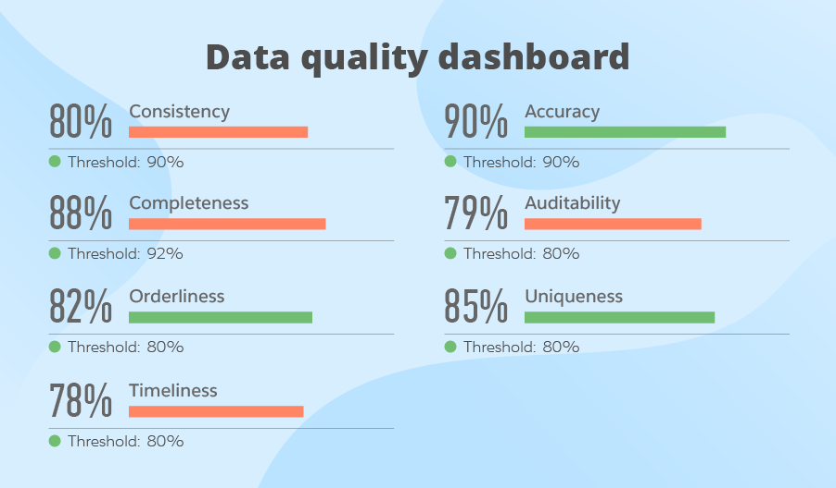
DQ Framework
Something similar to provide bird’s eye view

Slide 40
Iterative Random Forests
Extension of CART
Don’t rely on distributional assumptions and can accomodate non-linear relations
Build random forest trained on complete observations (initial matrix)
Initial variables are imputed typically using mean of the variable
Iterative in that variables with least number of missing values are imputed first using predictions from missing forests
To impute a missing variable in an observation, fit the observation into the trained random forest
Update the matrix of observations with imputed data
Repeated for each variable till predictions stabilize
Notes:
https://arxiv.org/pdf/1105.0828.pdf
In video by statquest:
There will be proximity matrix
At the end of training random forest, when a new obs comes in it will be fitted and see which nodes are nearest to it based on proximity matrix
Then do a ‘voting’ to see which variable fits best (freq x weight)

Slide 41
MICE Imputation
MICE = multiple imputation by chained equation
Chained equation because each variable can have its own type of imputation (e.g. linear reg, logistic reg, CART, RF)

Slide 42
MICE Imputation
Simple imputation (e.g. mean/mode) for every missing value. They are “place holders”
Place holders for a variable are set back to missing
Observed values from the variable in step 2 are regressed on the other variables in the imputation model (ie. variable is now dependent var with other independent var)
Missing values of the variable in step 2 are replaced with imputations from previous imputation model
Steps 2 to 4 repeated for each variable and this is a cycle
Cycle is repeated and imputations being updated at each cycle

Slide 43
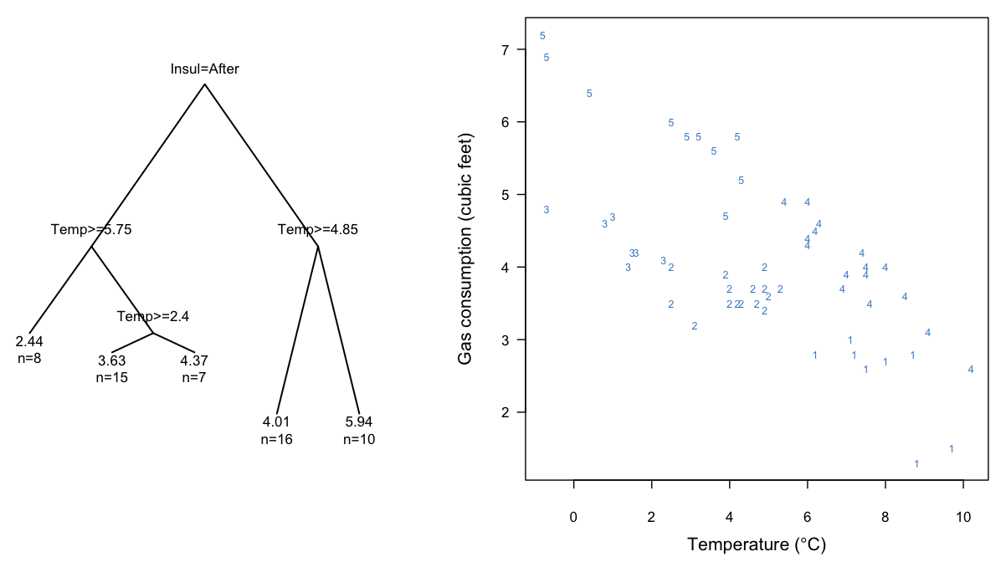
CART MICE
Build CART by recursive partitioning using complete observations to form data matrix Y
For the first variable w/ missing values, impute the missing observations with random draws from their same variable and update Y
For each missing value, find the terminal node they end up in
Make a random draw among the members in the node and the observed value will be the imputed value
Update imputed missing values to Y
Re-run steps 2 to 5
Repeat steps 1 to 6 m times to form m sets
Notes:
http://elisedusseldorp.nl/elise/wp-content/uploads/2018/05/Doove2014CSDA.pdf
Work from the variables with least amount of missing values
Clusters represent the nodes with donors

Slide 44
RF MICE
Form data matrix Y using complete dataset, and another data matrix Y initial
For the first variable w/ missing values, impute the missing observations with random draws from their same variable and update Y
Random forests first draws k bootstrap samples from complete portion of Y initial (Y complete initial)
One tree fitted for every bootstrap sample. Result is k trees, where each tree has several leaves. Each leaf includes a subset of Y complete initial which are called donors
For missing observations, determine which leaf they will end up according to the k trees
Take all donors from the k leaves and randomly select one observed value from the donors, then update Y
Repeat steps 2 to 6 to perform it x iterations
Repeat steps 1 to 7 m times to obtain m datasets
Notes:
http://elisedusseldorp.nl/elise/wp-content/uploads/2018/05/Doove2014CSDA.pdf

Slide 45
KNN
Identifies k closest observations based on Gower distance and compute weighted average of these k observation
Distance between 2 observations is weighted mean of contributions of each variable, where weight should represent the importance of the variable
Continuous variables replaced with median
Categorical variables replaced with mode
Notes:
https://www.researchgate.net/publication/309336197_Imputation_with_the_R_package_VIM

Slide 46
Hmisc aregImpute
A type of multiple imputation strategy
Use aregImpute method which uses additive regression, bootstrapping and predictive mean matching
Different bootstrapping samples used for each of multiple imputations
Flexible additive model is fitted on samples taken with replacement from original data and missing values are predicted using non-missing values
PMM to impute missing values
Highlights:
Assumes linearity in variables being predicted
Fisher’s optimum scoring method is used for predicting categorical variable
Notes:
http://rstudio-pubs-static.s3.amazonaws.com/233370_56612580566d4c46a10ff2f70fa858a4.html
Additive regression:
Non parametric regression method
Understand effective of each variable individually/marginally
Bootstrap:
Takes all aspects of uncertainty into account
Used to approximate the process of drawing predicted values from a full Bayesian predictive distribution
Maximise R^2
Pmm: https://stefvanbuuren.name/fimd/sec-pmm.html; https://statisticalhorizons.com/predictive-mean-matching. A type of hot deck method
Only observed values used to estimate the model to produce a set of coefficients β
Draw randomly from posterior predictive distribution of β and produce a new set of coefficients β∗ (Bayesian step needed to create some random variability in imputed values). Typically this would be a random draw from a multivariate normal distribution with mean β and the estimated covariance matrix of β (with an additional random draw for the residual variance). This step is necessary to produce sufficient variability in the imputed values, and is common to all “proper” methods for multiple imputation.
Calculate predicted values for observed and missing Y using β*
For each case where Y is missing, find closest predicted values among cases where Y is observed and draw randomly from one of these three close cases to impute missing value. BUT IN aregImpute instead of closest match, optimal weighted probability sampling of donors is used
Initialize NAs to values from a random sample of the variable
For variables containing NAs, draw a sample with replacement from complete portion of the dataset (bootstrapping)
Fit a flexible additive model to predict the target variable while finding the optimum transformation of it.
Impute each missing value of target variable with observed variable (pmm)

Slide 47
Hmisc aregImpute
Initialize NAs to values from a random sample of the variable
For variables containing NAs, draw a sample with replacement from complete portion of the dataset (bootstrapping)
Fit a flexible additive model to predict the target variable while finding the optimum transformation of it.
Impute each missing value of target variable with observed variable (pmm)
Notes:
Pg 17: https://cran.r-project.org/web/packages/Hmisc/Hmisc.pdf
steps

Slide 48
FAMD
Factorial analysis
Dimensionality reduction method BUT is not a mixed variable version of PCA as mentioned by the paper
Missing values imputed with initial values such as mean of variable for continuous variables and proportion of category for each category
Perform FAMD on complete dataset
Impute missing values with reconstruction formula to compute a fitted matrix. Missing values will be replaced by fitted values
In short, principal components obtained from the initial ‘complete’ data is used to reconstruct the data and impute missing values
Notes:
https://www.researchgate.net/publication/299498837_missMDA_A_Package_for_Handling_Missing_Values_in_Multivariate_Data_Analysis
https://arxiv.org/pdf/1301.4797.pdf

Slide 49
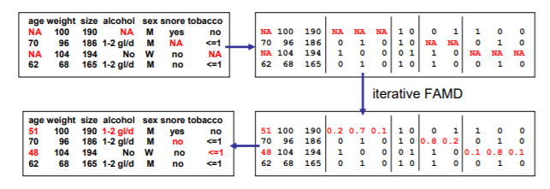
FAMD
Missing values imputed with initial values such as mean of variable for continuous variables and proportion of category for each category
Perform FAMD on complete dataset
Impute missing values with reconstruction formula to compute a fitted matrix. Missing values will be replaced by fitted values
Repeat until change in fitted matrix falls below predefined threshold

Slide 50
Bayesian PCA
Not built for MIXED data
Uncertainty on the parameters is taken into account using a Bayesian treatment of PCA
Builds on conventional PCA in that there is probability distribution of parameters involved to reflect the uncertainty and variance in the missing values instead of providing a point estimate
Automatically detects number of effective dimensions for PCA
Based on an iterative algorithm that alternates the imputation of the data set and draw of PCA parameters in a posterior distribution (posterior distribution determined by prior distribution)
Notes:
https://www.researchgate.net/publication/299498837_missMDA_A_Package_for_Handling_Missing_Values_in_Multivariate_Data_Analysis
https://cran.r-project.org/web/packages/missMDA/missMDA.pdf
https://arxiv.org/pdf/1401.5747.pdf
https://papers.nips.cc/paper/1549-bayesian-pca.pdf
Posterior distribution calculated based on data augmentation. Augmenting observed data by predictions on missing data
DA simulates alternatively imputed values and parameters using Markov chain which converges in probability to the observed posterior distribution
Imputing from current parameters and observed data
Drawing of new parameters from posterior given new imputation and a prior distribution on model’s parameters
Repeated a number of times
At the end of the algorithm draws from posterior distribution are obtained from an incomplete dataset
Impute by drawing from posterior distribution given current parameters
Draw from updated posterior distribution by data from step 1 given PCA based on step 1

Slide 51
Bayesian PCA
Imputation by random draw from posterior distribution given current parameters in dataset
Recalculate posterior distribution with imputed dataset
Draw from recalculated posterior distribution given PCA applied on imputed dataset

Slide 52
Differences Between K-Means and Hierarchical Clustering
 | K-Means | Hierarchical
Time complexity | O(n) | O(n^2)
Initial Clustering | Random choice of clusters | Top-down or bottom up splitting
Shape of Clusters | Hyper spherical e.g. circle/sphere
K | Requires initial input | Can find appropriate k by interpreting dendrogram
Closeness | Data points distance to centroid of cluster | Distance between data points/cluster (ie. no centroid)
Notes:
https://www.analyticsvidhya.com/blog/2016/11/an-introduction-to-clustering-and-different-methods-of-clustering/

Slide 53
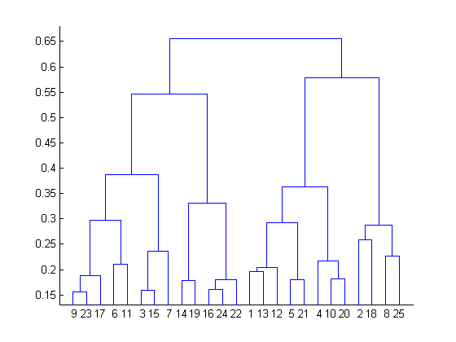
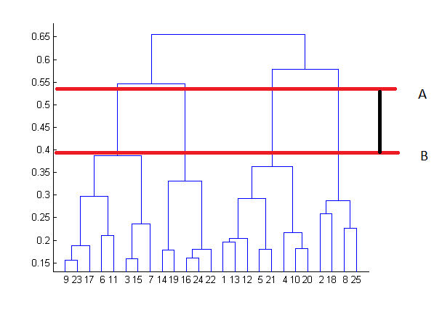
Hierarchical Clustering
Results can be displayed on dendrogram
Start with 25 data points assigned into separate clusters
Height of dendrogram represents distance between 2 clusters in data space
Number of clusters: best choice is the number of vertical lines in the dendrogram cut by a horizontal line that can transverse the maximum distance vertically without intersecting a cluster
Distance can be calculated by: Euclidean/Manhattan etc
Notes:
https://www.analyticsvidhya.com/blog/2016/11/an-introduction-to-clustering-and-different-methods-of-clustering/

